Slide 1


Predicting Chicago Crime
by Paul Schmidt

Slide 2
Outlining the Presentation
I. Introduction to Chicago Crime
A. Context on Chicago Crime
B. The Research Question
C. Method of Testing
II. Preliminary Analysis of Datasets
A. Analyzing Crime Characteristics
B. Analyzing Geography of Crime
C. Analyzing Weather’s Effect on Crime
III. Crafting a Solution
A. Model Creation and Tuning
B. Testing on Holdout
IV. Model Relevance

Slide 3
I. Introduction to Chicago Crime
I. Introduction to Chicago Crime
II. Analysis of Data
III. Crafting a Solution
IV. Model Relevance

Slide 4
I. Introduction to Chicago Crime Context on Chicago Crime
The City of Chicago
Third largest city in the US behind New York and Los Angeles
Currently, the population is 2.679 million
Crime in Chicago
Since the late 1800s, Chicago has been infamously known for its crime rates.
Crime, as is often the case, is concentrated in certain neighborhoods

Slide 5
I. Introduction to Chicago Crime What Is the Need?
The Need
Crime affects various aspects of life for the citizen:
Peace of mind
Commuting
Location of living
Education
Life expectancy
Crime also affects various aspects of the police force:
Staffing size
Training emphasis
Geographic location

Slide 6
I. Introduction to Chicago Crime What Is Its Solution?
The Solution
While crime is not limited to a zip code, it does have recognizable and predictable patterns.
For the citizen, these patterns empower by:
Informing of dangerous times and places
Assisting in the decision of living location
For the police force, these patterns empower by:
Knowing how to staff their teams (time and location)
Knowing what training to emphasize for the task force
The Goal: reliably predict crime locations and times
Predefined accuracy threshold: 85%

Slide 7
II. Analysis of Data
I. Introduction to Chicago Crime
II. Analysis of Data
III. Crafting a Solution
IV. Model Relevance

Slide 8
II. Analysis of Data The Datasets
Crime Dataset: CLEAR (Citizen Law Enforcement Analysis and Reporting)
Extracted directly from the Chicago Police Department (CPD)
Spans from 2001 to the present with over 6.5 million datapoints
Contains a variety of features like type of crime and location
Weather Dataset: Chicago O’Hare Station within Illinois ASOS Network
Made available through Iowa State University
Spans from before 2001 to the present
Populated with one to two entries per hour
Contains variety of continuous and categorical features such as real-feel temperature and precipitation recorded

Slide 9
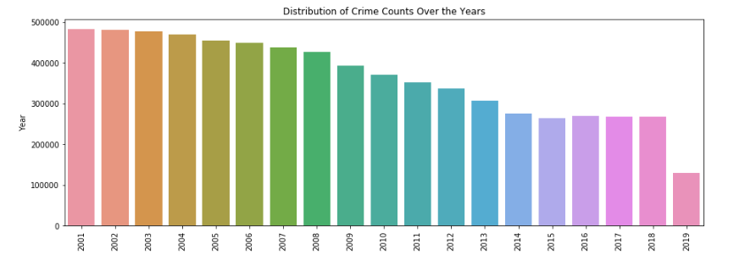
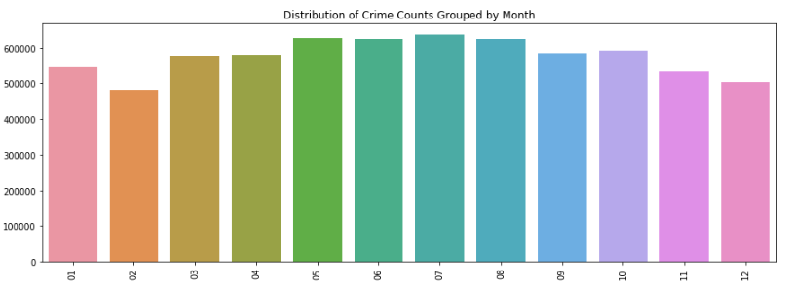
II. Analysis of Data Characteristics of Crime (A)
Crime rates over the years
Declined from 2001 to 2013
Plateaued from 2014 to present
Incomplete data in 2019
Crime distribution across months
Spikes in crime during summer months
Decrease is strong winter months like February

Slide 10
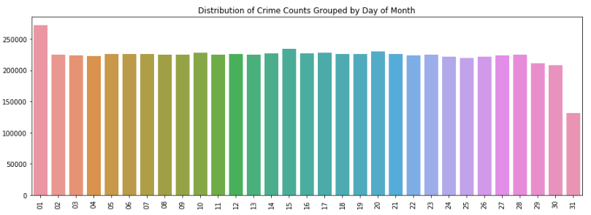
II. Analysis of Data Characteristics of Crime (B)
Crime rates across day of month
Decrease in activity on 29th, 30th, and 31st day of month
Increase on 1st day of month
Slight increase on 15th day of month
After assessing the normal distributions of the 15th day against the distributions of all other days, the increase in the 15th day is indeed statistically significant (containing a t-value of 2.527 and p-value of 1.15%)

Slide 11
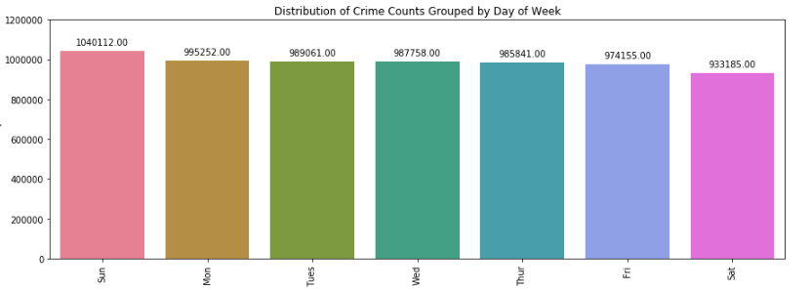
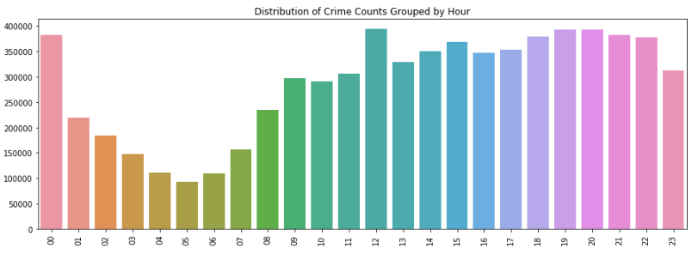
II. Analysis of Data Characteristics of Crime (C)
Crime rates across day of week
Polarity in weekends
Decrease in activity on Saturdays
Increase on Sundays
Steady throughout the weekdays
Crime rates across hours of day
Greater activity in hours after noon
Peaks are at noon and 8:00pm
Low activity during the early mornings
Lowest rate at 5:00am

Slide 12
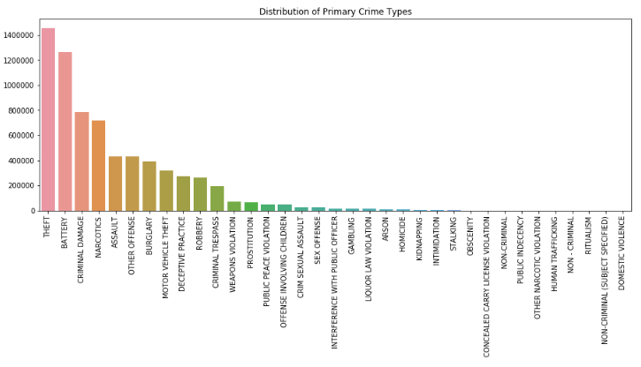
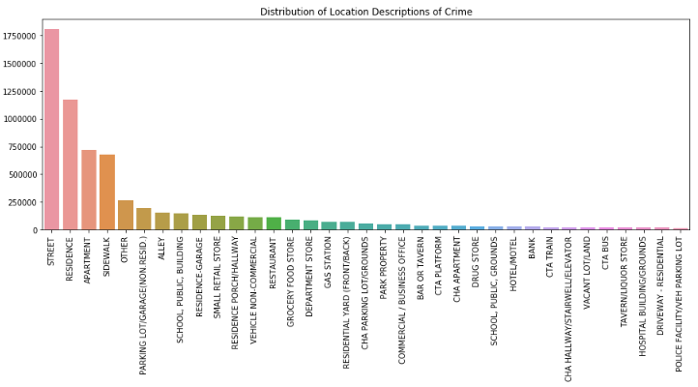
II. Analysis of Data Characteristics of Crime (D)
Top 5 Primary Crime Types:
Theft
Battery
Criminal Damage
Narcotics
Assault
Top 5 Crime Activity Areas:
Street
Residence
Apartment
Sidewalk
Other

Slide 13
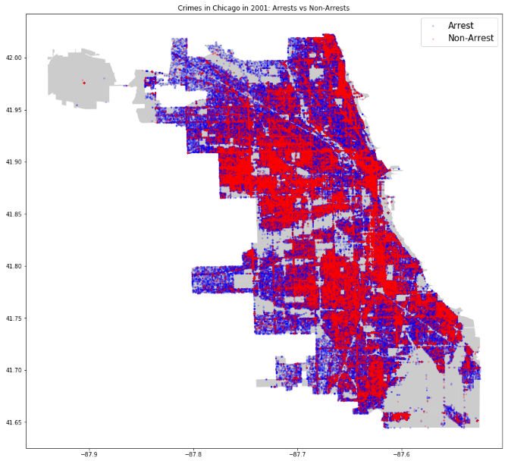
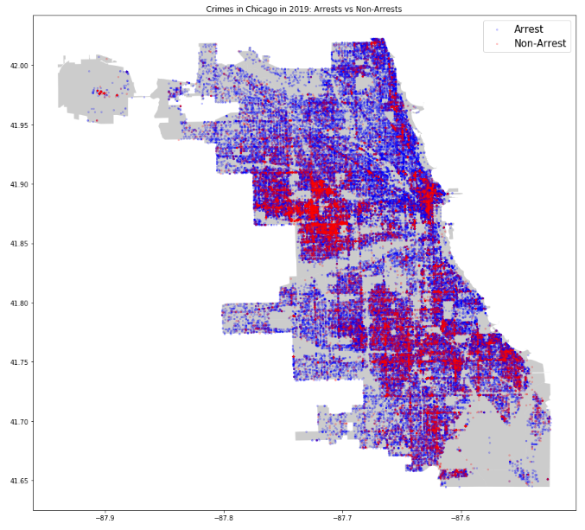
II. Analysis of Data Geography of Crime (A)
Visualizing the geographical distribution of crime between 2001 and 2019

Slide 14
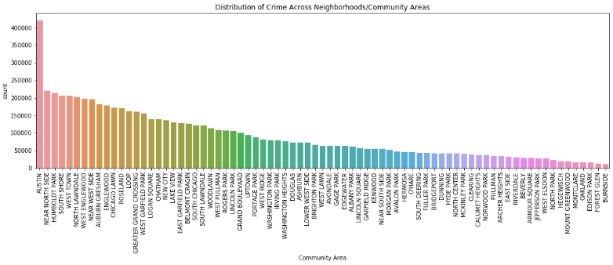
II. Analysis of Data Geography of Crime (B)
Crime across Neighborhoods:
Austin is considerably more active than other neighborhoods
Steady decrease throughout remainder

Slide 15
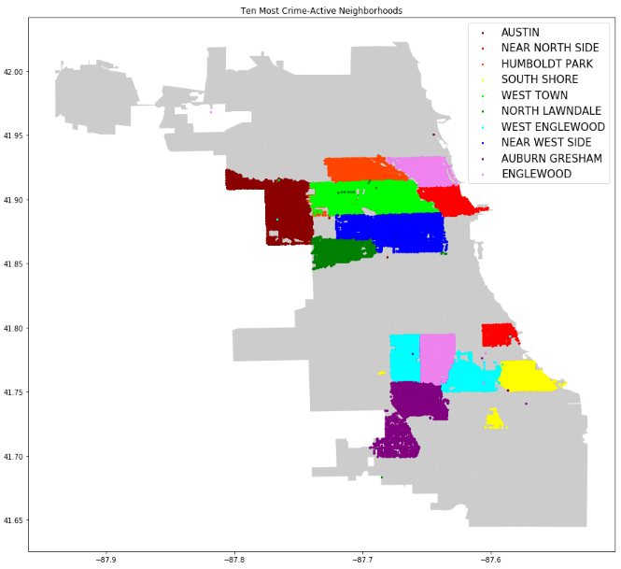
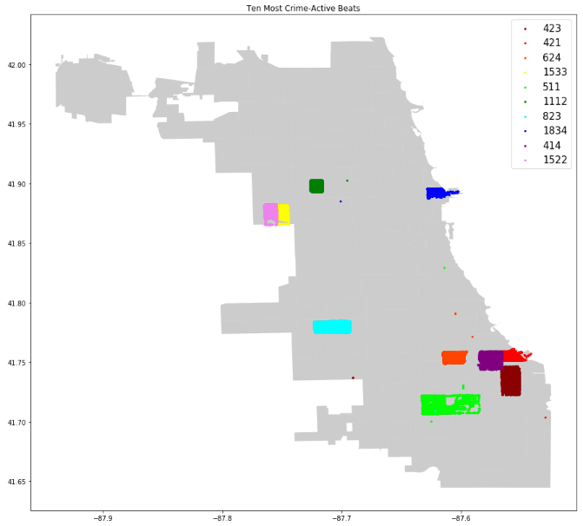
II. Analysis of Data Geography of Crime (C)
Visualizing most active sub-locations within Chicago

Slide 16
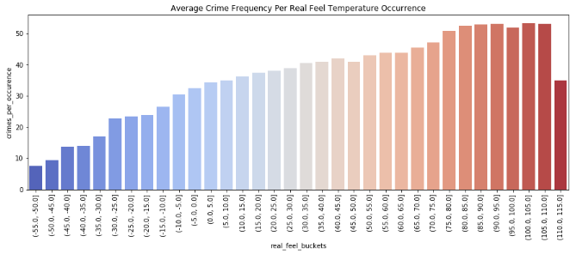
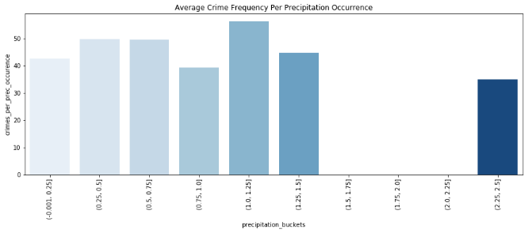
II. Analysis of Data Weather’s Effect on Crime
Temperature appears to have a strong causal relationship with frequency of crime
For a given hour between -55 and -50 degrees Fahrenheit: 7.5 crimes will occur
For a given hour between 100 and 105 degrees Fahrenheit: 53.3 crimes will occur
The correlation is not nearly as evident when considering precipitation
Surprisingly, maximum crime frequency takes place during hours with 1” and 1.25” inches of precipitation
Unsurprisingly, minimum crime occurrence is when precipitation is heaviest

Slide 17
III. Crafting a Solution
I. Introduction to Chicago Crime
II. Analysis of Data
III. Crafting a Solution
IV. Model Relevance

Slide 18
III. Crafting a Solution Overview of Models
The two model types consist of predicting daily crime for:
The city as a whole
The individual 77 neighborhoods

Slide 19
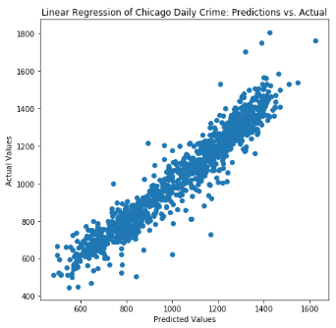
III. Crafting a Solution Predicting Daily Crime in Chicago (A)
Preliminary model scores for the City:
Linear: 91.55%
Lasso: 90.63%
Ridge: 91.55%
Random Forest: 90.23%
Neural Network: 67.82%

Slide 20
III. Crafting a Solution Predicting Daily Crime in Chicago (B)
After assessing, linear models with corresponding regularizations were chosen for model tuning due to:
Computational efficiency
Reliable accuracy
Communicable reasoning
After testing Linear, Lasso, and Ridge models, the tuned Ridge Regression model (on the training data) was the most accurate:
Original Ridge: 91.55%
Hyperparameter default of: “0.001”
Tuned Ridge: 94.16%
Hyperparameter alpha of: “0.01”

Slide 21
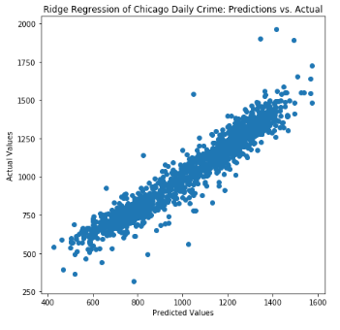
III. Crafting a Solution Predicting Daily Crime in Chicago (C)
Testing Ridge model on Holdout:
Accuracy: 91.47%
Mean Absolute Error: 54.63
Polarizing Coefficients:
Positive correlations:
Years 2001, 2003, 2002, 2004
Dew_pt_temp
First day of month
Negative correlations:
Years 2019, 2015, 2017, and 2016
Precipitation_by_hour
Rel_humidity

Slide 22
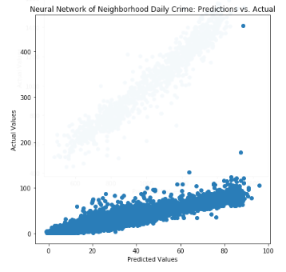
III. Crafting a Solution Predicting Daily Crime in Neighborhoods (A)
Preliminary model scores for Specified Neighborhoods:
Linear: 73.53%
Lasso: 03.10%
Ridge: 73.53%
SVR: 72.66%
Random Forest: 84.93%
Neural Network: 86.47%

Slide 23
III. Crafting a Solution Predicting Daily Crime in Neighborhoods (B)
After assessing, deep learning models were chosen for model tuning:
Pro: Reliable accuracy
Con: Computationally demanding
After tuning RFR and MLP on samples of data, MLP seems to provide greater accuracy:
RFR accuracy improvement: 1.78% (from 84.93%)
Hyperparameters: {'n_estimators': 800, 'min_samples_split': 2, 'min_samples_leaf': 2, 'max_features': 'auto', 'max_depth': 100, 'bootstrap': True}
MLP accuracy improvement: 7.78% (from 86.47%)
Hyperparameters: {'alpha': 0.0001, 'hidden_layer_sizes': (100, 50)}

Slide 24
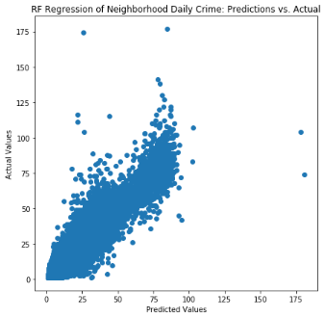
III. Crafting a Solution Predicting Daily Crime in Neighborhoods (C)
Testing RFR model on Holdout:
Accuracy: 86.88%
Observations:
When narrowing geographical influence, there is considerably greater disparity in predictions
As mentioned, this model is incredibly computationally demanding:
Tuning on sample
Implementing on holdout

Slide 25
IV. Model Relevance
I. Introduction to Chicago Crime
II. Analysis of Data
III. Crafting a Solution
IV. Model Relevance

Slide 26
IV. Model Relevance Predicting Daily Crime in City (A)
Ridge Regression
Why Linear?
Surprisingly, when observations are restricted to a consistent and large location, crime activity is very predictable
Follows normal distributions
Consistent patterns derived from relatively few features
Why Ridge?
This model outperformed other models while providing interpretable reasonings for its results
Provides direct insights of feature importance on final prediction
L2 Regularization penalizes high correlating features in order to avoid overfitting (benefit over simple Multi-Variable Linear Regression)

Slide 27
IV. Model Relevance Predicting Daily Crime in City (B)
Ridge Regression
How does the model benefit?
The benefit of targeting daily crime activity assists the Chicago Police Department by helping:
Calculate daily staffing based on daily conditions
Prioritize training emphasis based on primary types of crime recorded
Forecast probable events throughout the day based on given daily conditions
Thinking Ahead?
To run in a production environment, the model may be adjusted to automatically run on monthly, weekly, and daily bases in order to inform officers on the expected crime rates and types for the predefined time increment
Because variance in crime activity is low across the years, the script should not require frequent maintenance
However, in order to optimize results, accuracy can be tuned on an annual basis to ensure consistency and relevance

Slide 28
IV. Model Relevance Predicting Daily Crime in Neighborhoods (A)
Random Forest Regressor
Why Ensemble Modeling?
Unsurprisingly, when creating a single model to predict all activity within smaller geographical sections of Chicago, activity is no longer simple and linear.
Different ethnic/economic patterns of neighborhoods contribute in more nuanced ways than a simple coefficient
Factors that affect one neighborhood may not affect another neighborhood in the same way
Why Random Forest?
When compared to support vector machines and neural networks models, this model was often more computationally demanding with the positive tradeoff of greater accuracy
Consistency across all folds of training and holdouts
Collective model performs better than single models of individual neighborhoods

Slide 29
IV. Model Relevance Predicting Daily Crime in Neighborhoods (B)
Random Forest Regressor
How does the model benefit?
The benefits of calculating neighborhood daily crime assists both:
Chicago Police Department
Staffing on the micro-level
Precision for crime fighting
Chicago neighborhood resident
Informs the resident when conditions are relatively dangerous
Empowers them in their choice of living location
Thinking Ahead?
As before, this model can be assessed for efficacy and adjusted accordingly on an annual basis
For the CPD: model automated and run on weekly and daily bases by continually pulling from the CLEAR database with 7-day forecast
For the resident: model provided by CPD in abbreviated format to inform residents of crime activity with precision

Slide 30
While crime does not have a zip code, it does have…
…patterns

Slide 31
Questions & Answers
https://github.com/paulbenschmidt/chicago-crime

